Slide 1
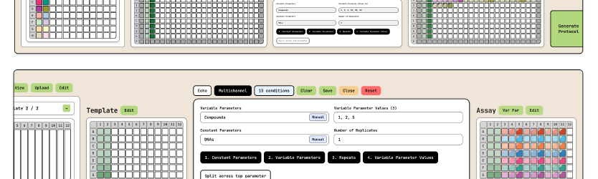


  A powerful, extendable, code-free platform designed to support scientists across all stages of assay development, from experimental design to data analysis.
Proposed Use
    AssayStudio enables scientists to design and run complex assays with minimal manual work. It automates plate layouts, calculates sample and control positions, and generates ready-to-use protocols for manual or robotic execution. After experiments, it processes raw data, organizes measurements, and applies advanced analytics. This streamlined workflow saves setup time, speeds up interpretation, and scales easily from small studies to high-throughput screening.
Problem Addressed
    Automation hardware is now common, but software that connects scientific intent to robotic execution is still limited. Current options often require coding skills or rely on expensive, complex LIMS systems with long onboarding. AssayStudio fills this gap by providing a lightweight platform that automates experiment setup and analysis without programming. Researchers can focus on science while the software ensures reproducibility, traceability, and flexibility - removing manual plate mapping, protocol writing, and error-prone data handling.
Technology Overview
AssayStudio uses a modular design built around three components: Stock Library, Assay Template, and Assay Parameters. This structure makes it easy to adjust designs, like switching plate formats, without starting over.
An AI assistant supports natural language configuration, and protocols can be generated for multiple liquid handlers or manual execution. For analysis, AssayStudio imports multi-format data, organises it into a structured model, and applies transformations.
Benefits
  Code-free interface removes need for programming skills, making advanced workflows accessible to all scientists.
  Eliminates manual plate mapping and protocol writing minimising mistakes, improving reliability and accelerating research timelines.
  Integrated data analysis reduces manual data handling and improves accuracy.
  Reproducibility and traceability through automated documentation.
  Rapid setup without lengthy onboarding.
Luis GOMEZ SAROSI
  Commercialisation Executive – FoNS
    e: l.gomez-sarosi@imperial.ac.uk
    t: +44 (0) 2075943798
Technology reference: 12255

Slide 2

Intellectual property information
    Protected under copyright law as original software code.
Link(s) to publications
Inventor information
  Dr Tim Kench- Tim Kench joined Prof Vilar’s group as a PhD student in October 2017 and since 2021 he has been a postdoctoral research associate. His work focuses on developing molecules that target different DNA and RNA structures and building high-throughput platforms for their synthesis and screening. As part of this work, he created AssayStudio, a platform designed to streamline experimental design and analysis for complex assays.
  Prof Ramon Vilar- Ramón Vilar is Professor of Medicinal Inorganic Chemistry in the Department of Chemistry. He leads a multidisciplinary team working to develop innovative chemical tools to study biological systems, with research spanning medicinal inorganic chemistry, molecular recognition, imaging, and environmental applications. His group is also focusing on developing automated platforms for the synthesis of optical probes and potential anticancer/antibacterial drugs, and their high throughput screening.

